Slide 1
Pac-Man project report
Amorim Arthur
Jiang Luc
Rampon Liam

Slide 2
Product description
Pac-Man game
Controllable player avatar with two modes
4 ghosts with different AIs
Score system (ghost killing + gum eating)
Several maps

Slide 3
Technical environment
Language: C++
Library: SDL (2.0)
IDEs: Code::Blocks, Eclipse(Windows) and Xcode (MacOS)

Slide 4
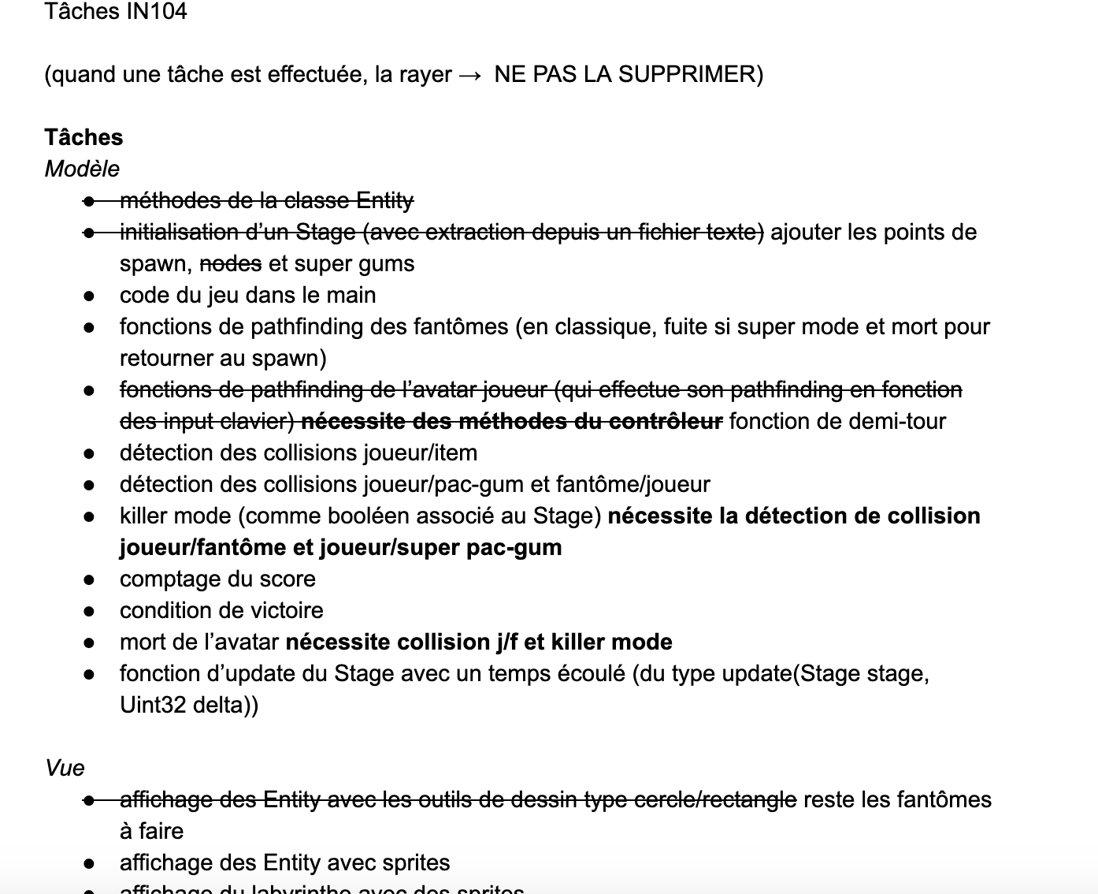
Software development plan
Project dispatched using MVC pattern
Tasks and dependencies between them written for coders to choose among
Current status: level displayed, avatar (movement) done, gum eatable, two ghosts have an AI

Slide 5
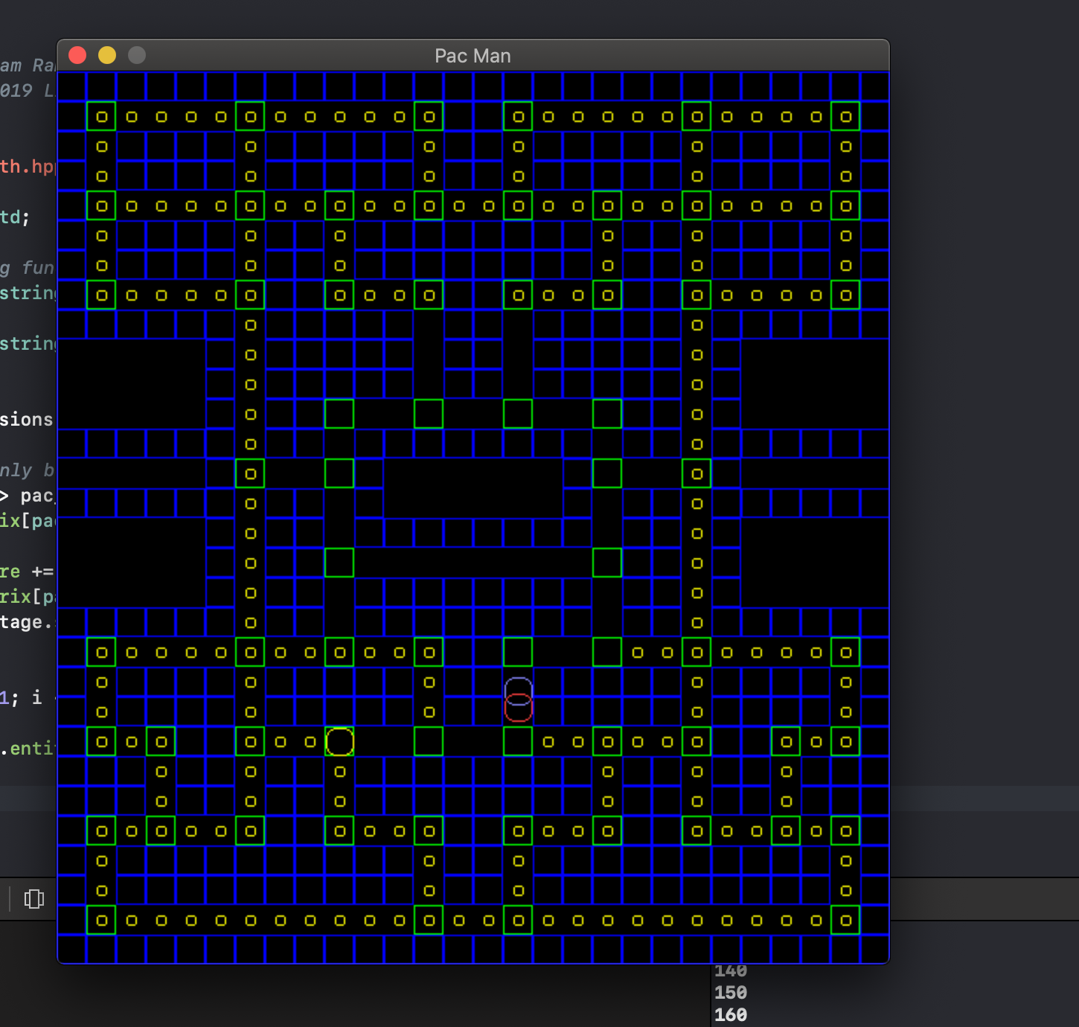
Results and issues
making SDL work on everyone’s PC
identifying the game’s graph structure
communication mishaps
no major scope change yet

